Slide 1
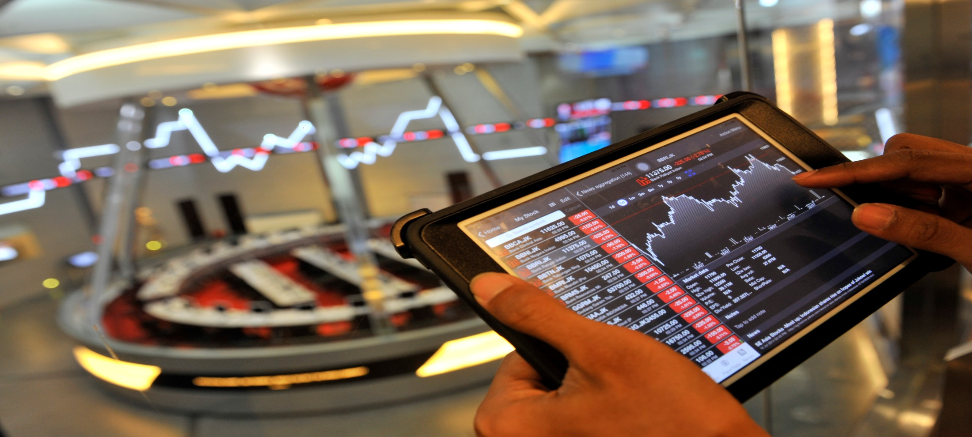
SEMINAR PASAR MODAL
Capital Market Career
The Indonesia Capital Market Institute (TICMI)

Slide 2

Indonesian Capital Market Potential

Slide 3
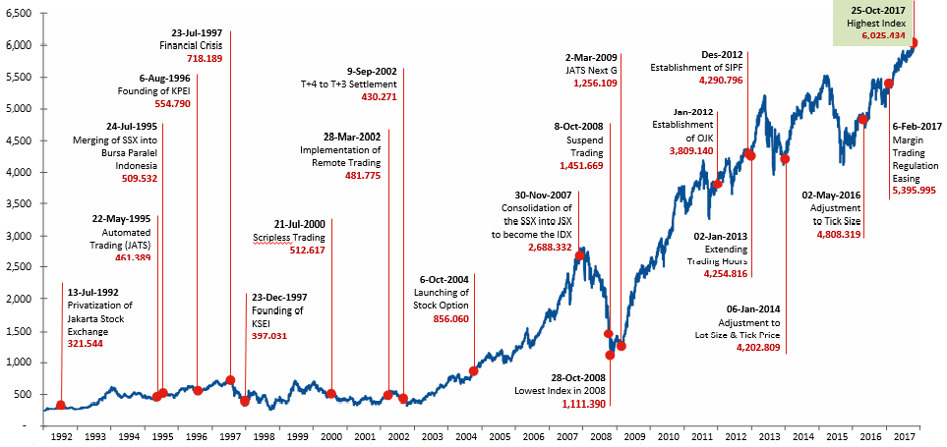
Capital Market 1992 – Oct 2017

Slide 4
Indonesia in ASEAN
Market Capitalization
in USD Billion
Listed Companies
Investor (2016)
(number of account, % total population)
*per September-2017
Source: Bloomberg, World Federation Exchanges (WFE) – August Edition

Slide 5

Capital Market
Career Opportunity

Slide 6


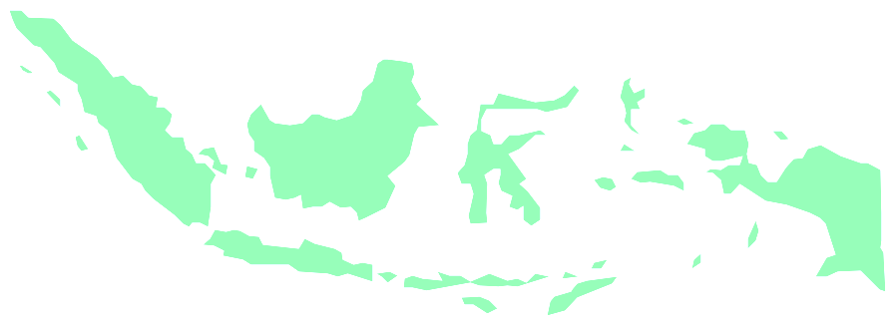
Investors vs Broker Dealers
612.078
4.128
RATIO
IDEAL
1 : 10
1 : 148

Slide 7
Capital Market Expertise
Finance
Statistics
Legal
Economics

Slide 8
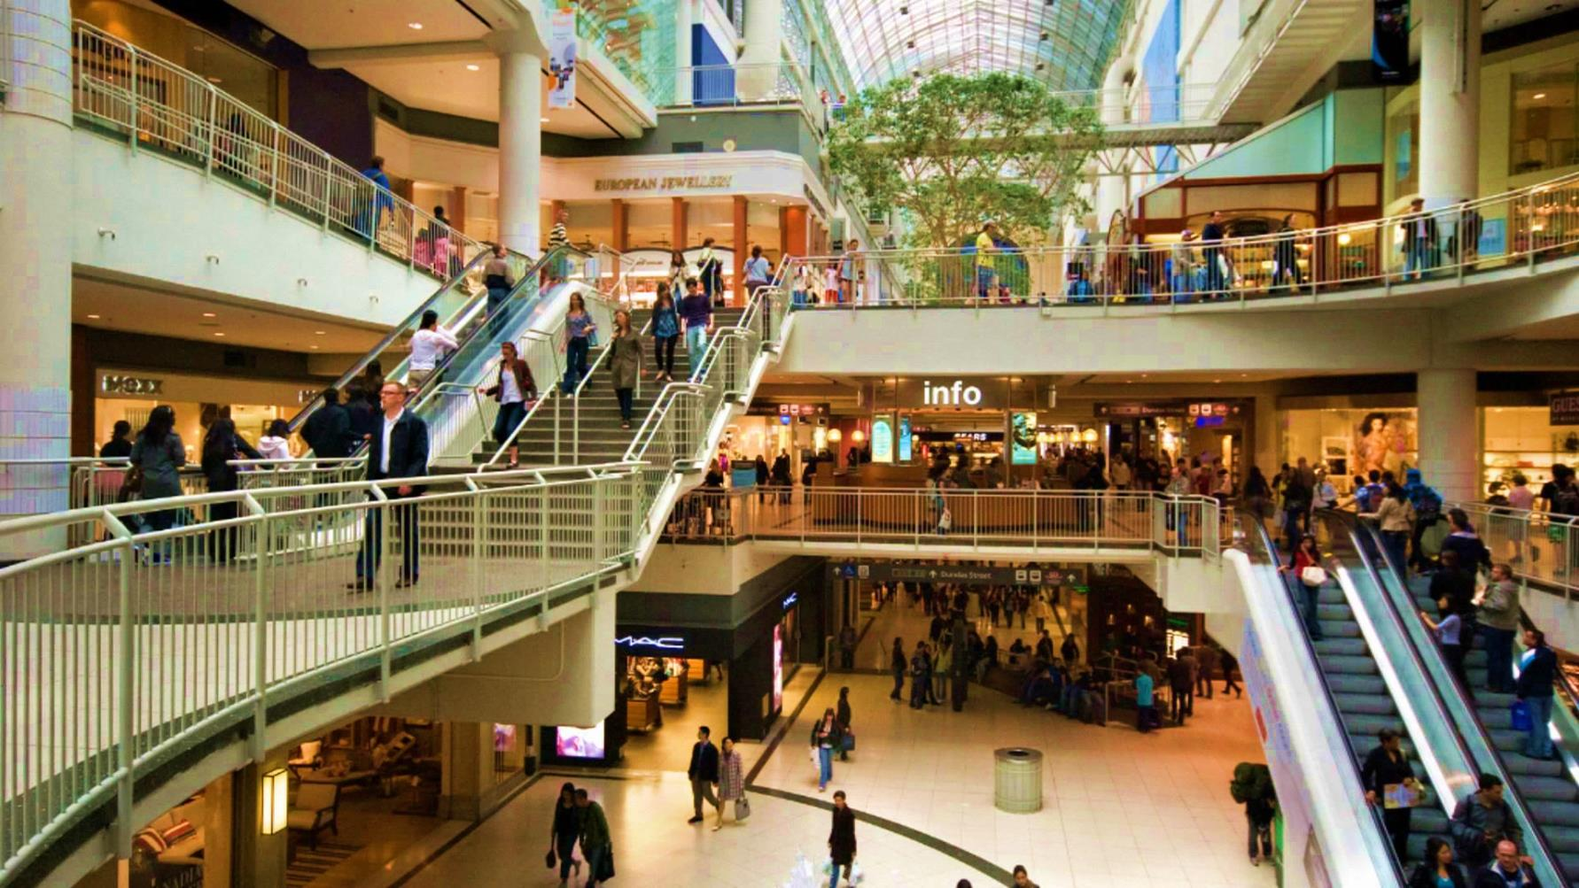
The Stock Exchange
Mall | SRO
Shops | Securites Company (Brokers)
Shopping Items | Stocks
Buyers | Investors

Slide 9

Indonesian Capital Market Structure
Otoritas Jasa Keuangan
(OJK)
Bursa Efek
(PT Bursa Efek Indonesia-BEI)
Lembaga Kliring dan Penjaminan
(PT Kliring dan Penjaminan Efek Indonesia-KPEI)
Lembaga Penyimpanan dan Penyelesaian
(PT Kustodian Sentral Efek Indonesia-KSEI)
EMITEN
Perusahaan Efek
Lembaga Penunjang
Profesi Penunjang
PEMODAL/INVESTOR
+ Penjamin Pelaksana Emisi (Underwriter)
+ Perantara Pedagang Efek
+ Biro Administrasi Efek
+ Bank Kustodian
+ Wali Amanat
+ Pemeringkat Efek
+ Penilai Harga Efek Indonesia (IBPA)
+ Penyelenggara Program Perlindungan Investor Efek Indonesia (SIPF)
+ TICMI
+ Akuntan
+ Notaris
+ Penilai
+ Konsultan Hukum
+ Domestik
+ Asing
+ Manajer Investasi

Slide 10










Indonesian Capital Market Structure
Self Regulatory Organizations (SRO)
100%
ownership
11.5% ownership
20%
ownership
Credit
Rating
Capital Market Education
Investor Protection Fund
Bond Pricing Agency
Media
Channel
Indonesia Securities Fund

Slide 11
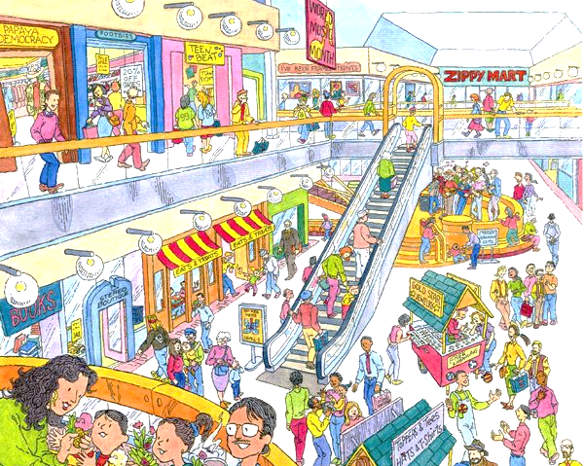
Pilihan Karir Pasar Modal dari Sisi Kelembagaan
REGULATOR
(OJK)
SUPPORT SYSTEM
(TICMI, PEFINDO, IBPA, dsb.)
OPERATOR
(Anggota Bursa, Manajemen Investasi, dsb.)
FACILITATOR
(BEI, KPEI, KSEI)

Slide 12
Legal
Strategic
Management Office
Corporate
Secretary
Special Project
General Affair
Human Capital
Accounting
Finance
Director of
Finance and Human Resources
Risk Management
IT Operation
IT Project
Management Office
IT Planning and Development
Director of IT and
Risk Management
Potential Issuer Development
Investor Development
Research and Development
Director of Business Development
Member Compliance
Market Surveillance
Director of Market Surveillance and Compliance
Membership Management and Monitoring
Trading Support and Development
Trading Operation
Director of
Trading and Membership
Issuer Information Management and Development
Privatization, Start-up, SME, and Foreign Listing
Listing Service and Issuer Monitoring
Director of Listing
Internal
Audit
President Director
Domestic Area Development
Corporate Communication
IDX Organization

Slide 13
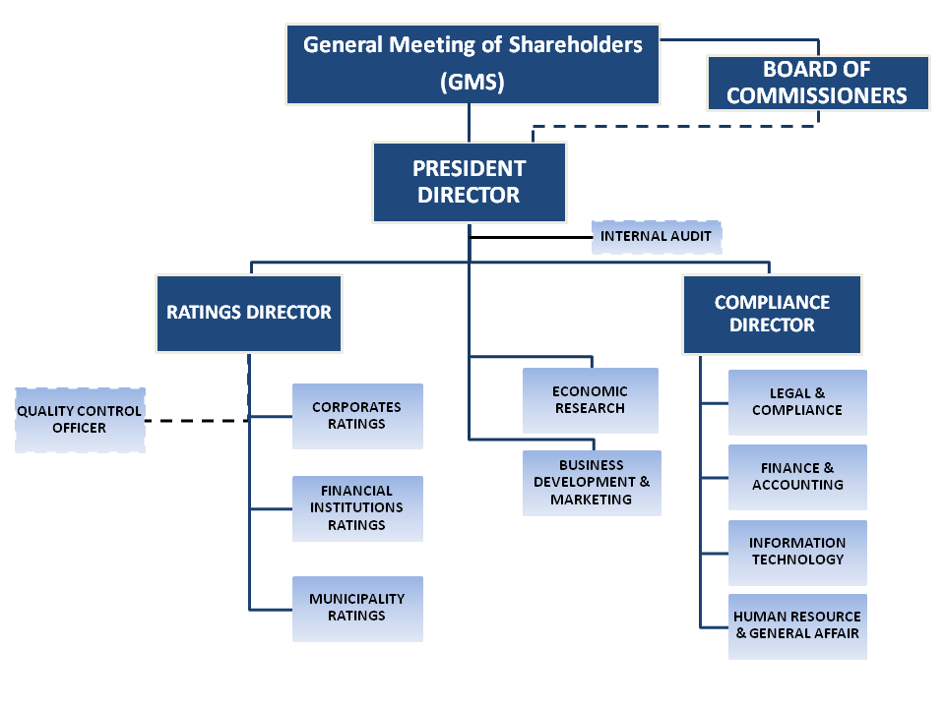
Struktur Organisasi Pefindo

Slide 14
Struktur Organisasi Anggota Bursa
President Director
Director
Director
Fin & Acc
Investment Banking
Fixed Income Sales & Trading
Research
Equity Sales & Trading
IT

Slide 15
Kompetensi yang Dibutuhkan Secara Umum
Kompetensi Teknis Yang Wajib Dikuasai:
- Dasar-Dasar Ekonomi
- Analisa Laporan Keuangan
- Mekanisme Perdagangan Pasar Modal
- Produk-Produk Pasar Modal
- Regulasi dan Etika Pasar Modal
Kompetensi Non Teknis Yang Wajib Dikuasai :
- Analytical Thinking
- Entrepreneurship
- Building Trust & Integrity
- Attention to Detail
- Strive for Excellence

Slide 16
Indonesian Capital Market Structure
Self Regulatory Organizations (SRO)
100%
ownership
11.5% ownership
20%
ownership
Capital Market Education

Slide 17
Our Priority
Education
References
Certification
Capital Market Experts
Capital Market Professional Development Program (CMPDP)
Career Development Center (CDC)
Qualified graduates
Academic & professional purposes
Interest on capital market
Willing to invest
Willing to work in capital market
Broading the knowledge
Self actualization
Ruang Informasi Digital TICMI (RIDMI)
Ikatan Alumni TICMI (ILUMI)

Slide 18
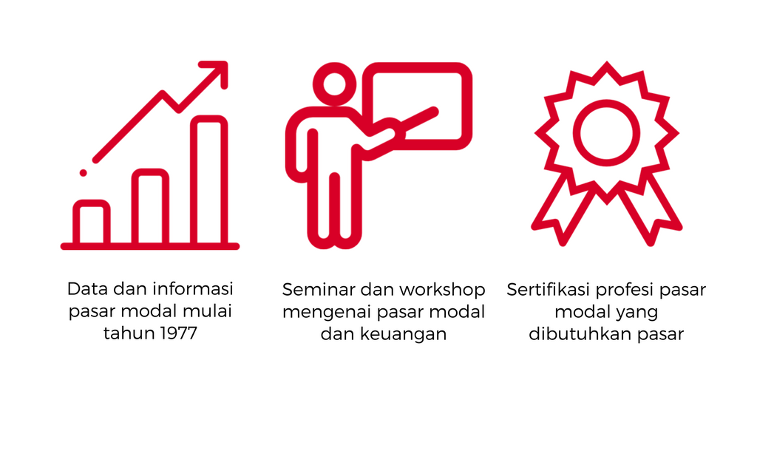
Our Services

Slide 19
Data Pasar Modal
Data
Aksi Korporasi
Transaksi Perdagangan
Data Statistik
Daftar Efek
Laporan Keuangan
Peraturan
Pengumuman
Daftar Lembaga Penunjang

Slide 20

ridmi
Ruang Informasi Digital TICMI

Slide 21

Koleksi Buku
ePustaka
eReader
Rak Buku
339 eksemplar
214 judul
14 artikel ekonomi & pasar modal
Perpustakaan pribadi
Koleksi buku/artikel/karya ilmiah
Fitur ebook yang user friendly
Riwayat peminjaman buku

Slide 22
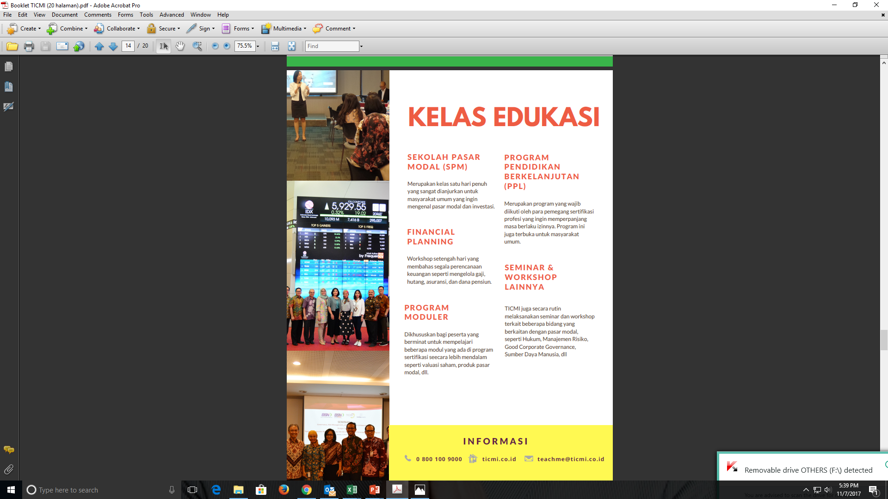

Slide 23
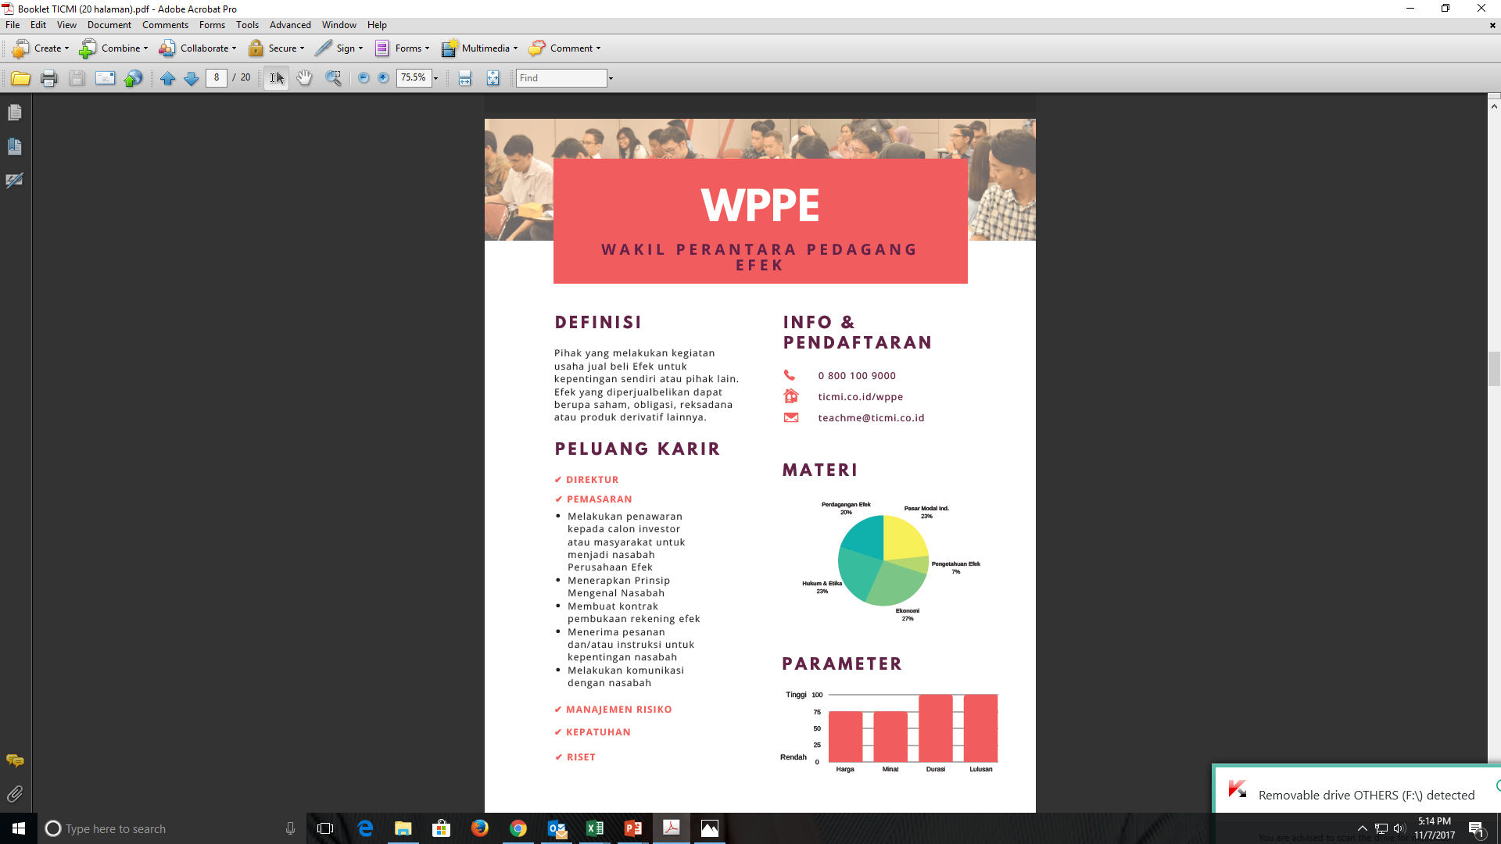

Slide 24
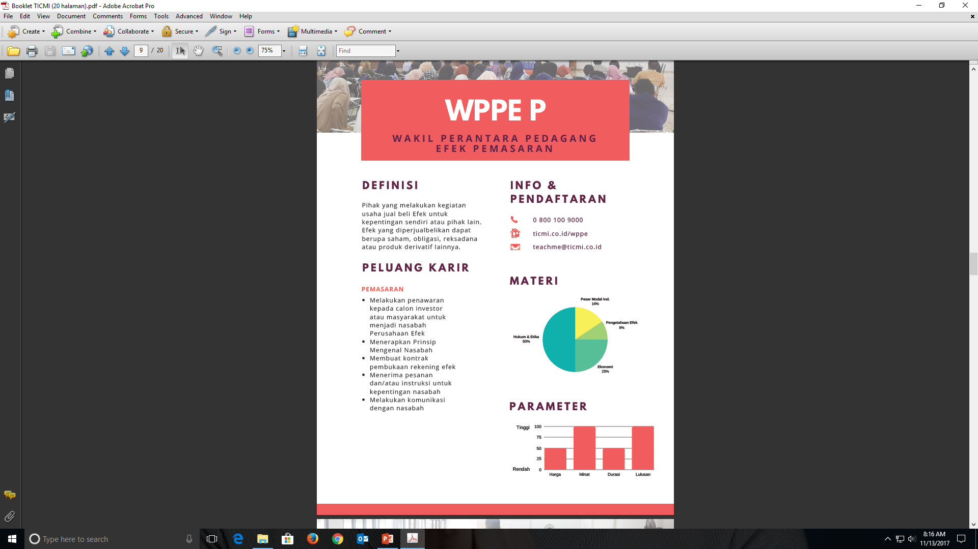

Slide 25
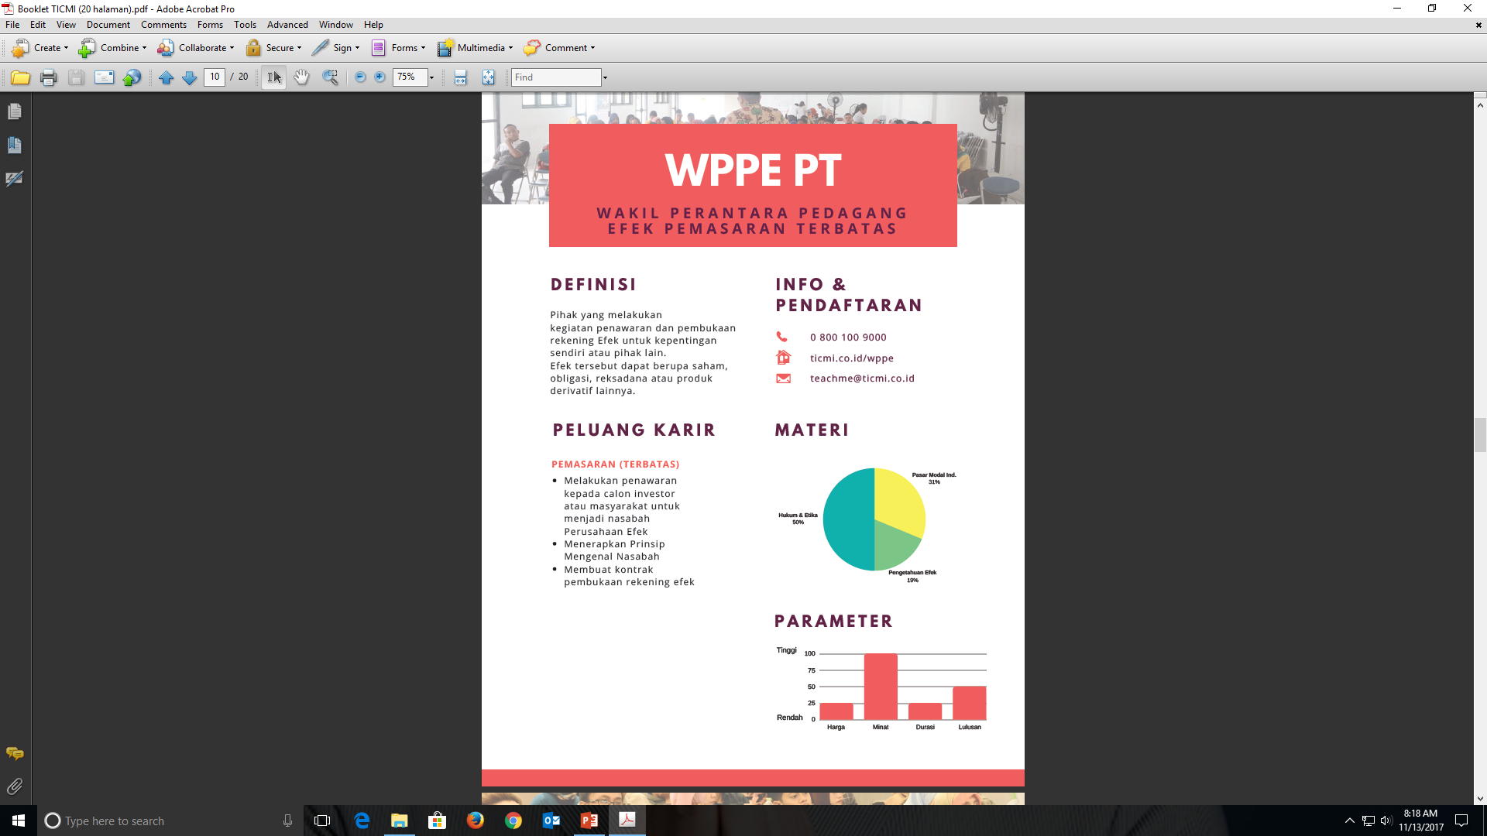

Slide 26
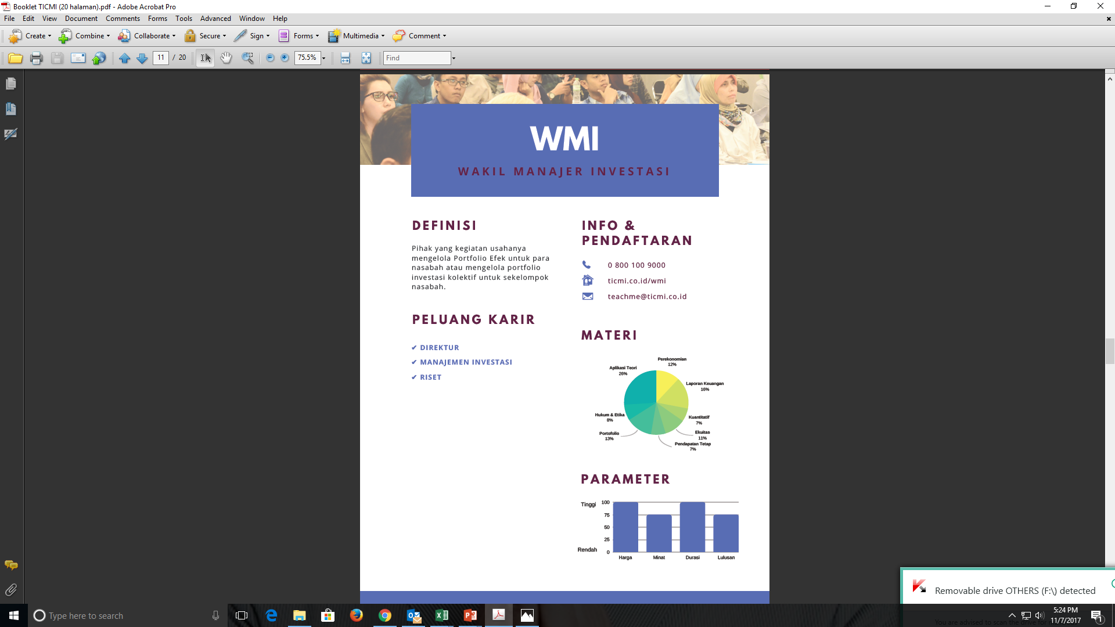

Slide 27
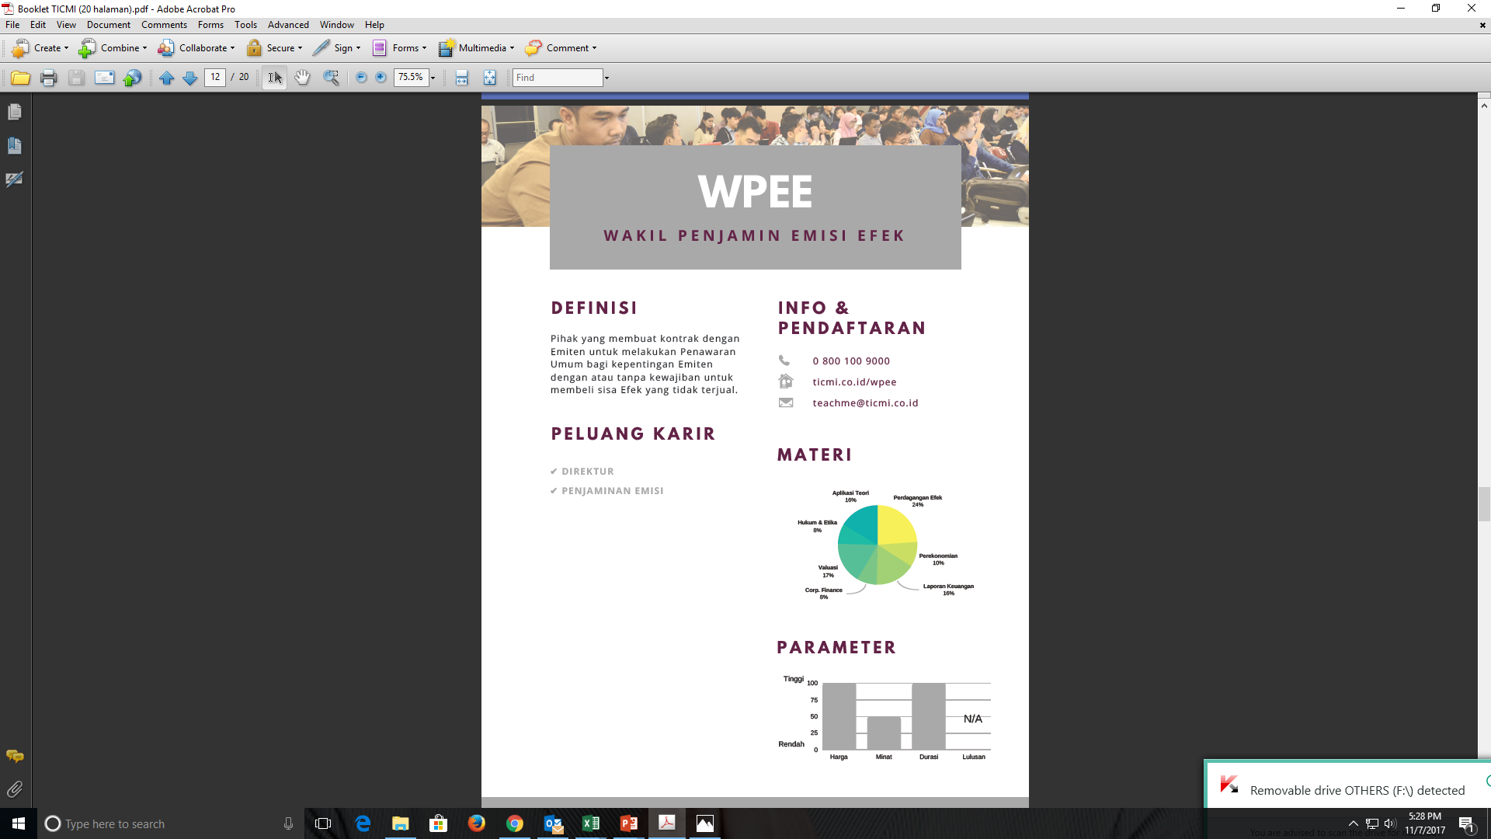

Slide 28
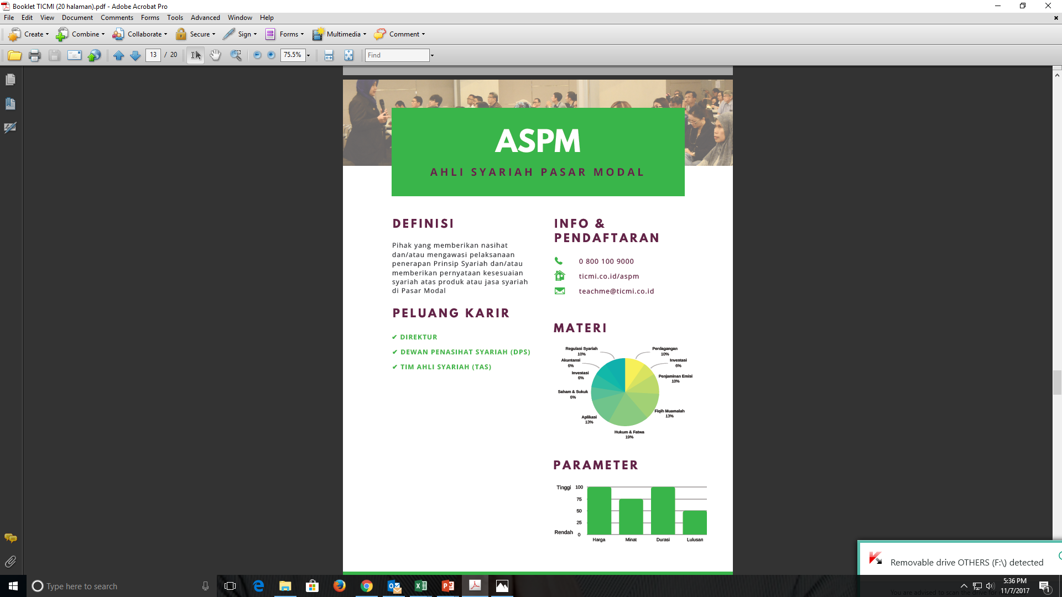

Slide 29
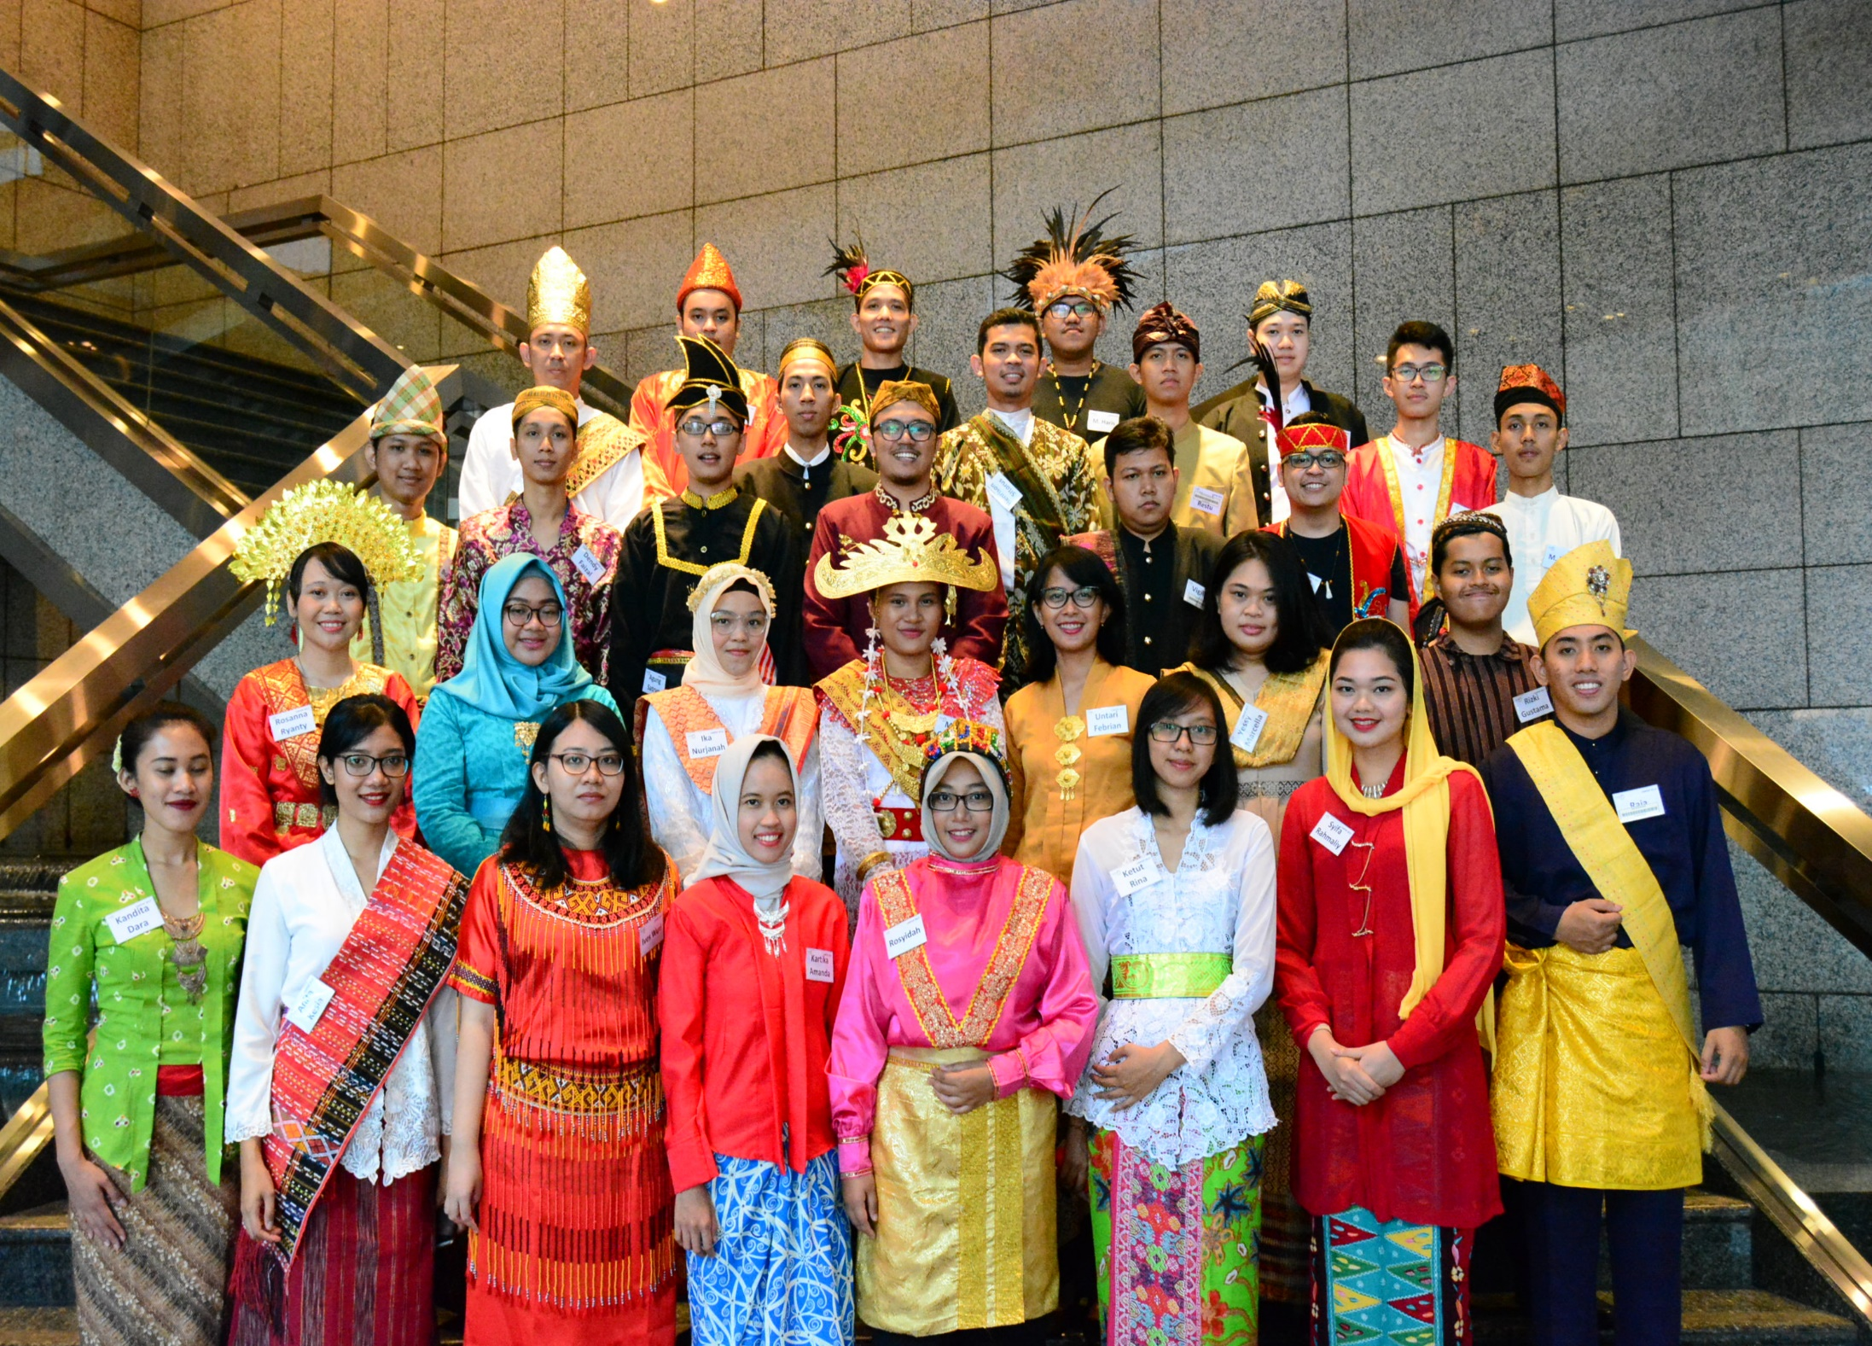
Capital Market Professional Development Program (CMPDP)

Slide 30
Why CMPDP?
First access to Indonesian capital market
Will be hired in BEI, KPEI, KSEI, and its subsidiaries
Will be professionally certified
Wakil Perantara Pedagang Efek (WPPE)
Wakil Manajer Investasi (WMI)
Work-life balance guaranteed
Insightful seminars, workshops, and trainings
The largest open recruitment in the industry
Received more than 4,000 applicants each year
Open for fresh graduate from any disciplines
Coached and mentored by industry experts
Extracurricular activities

Slide 31
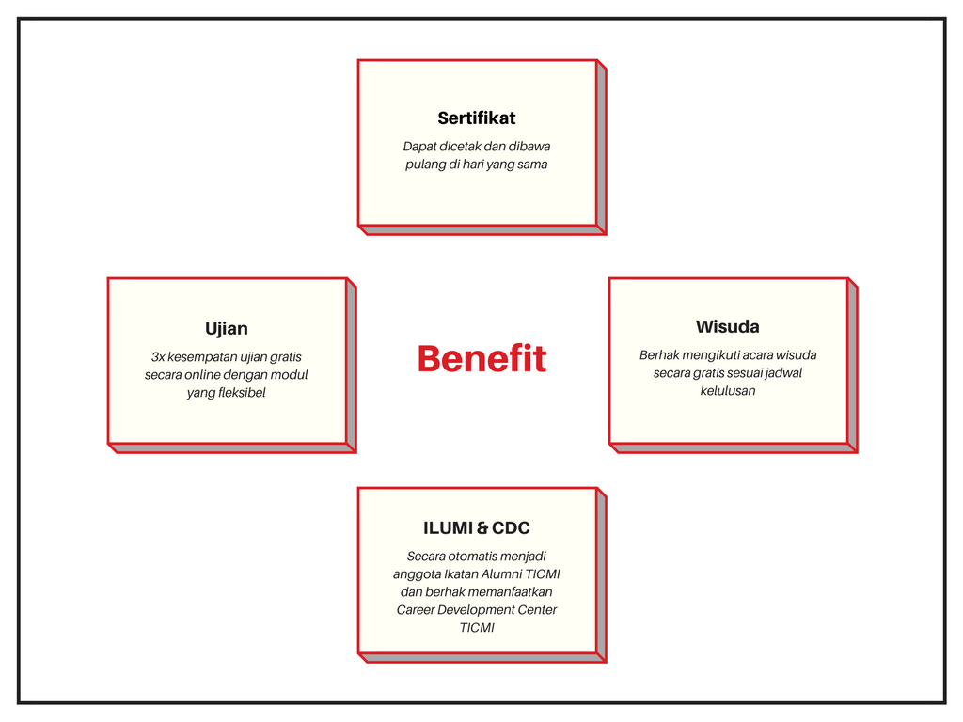

Slide 32
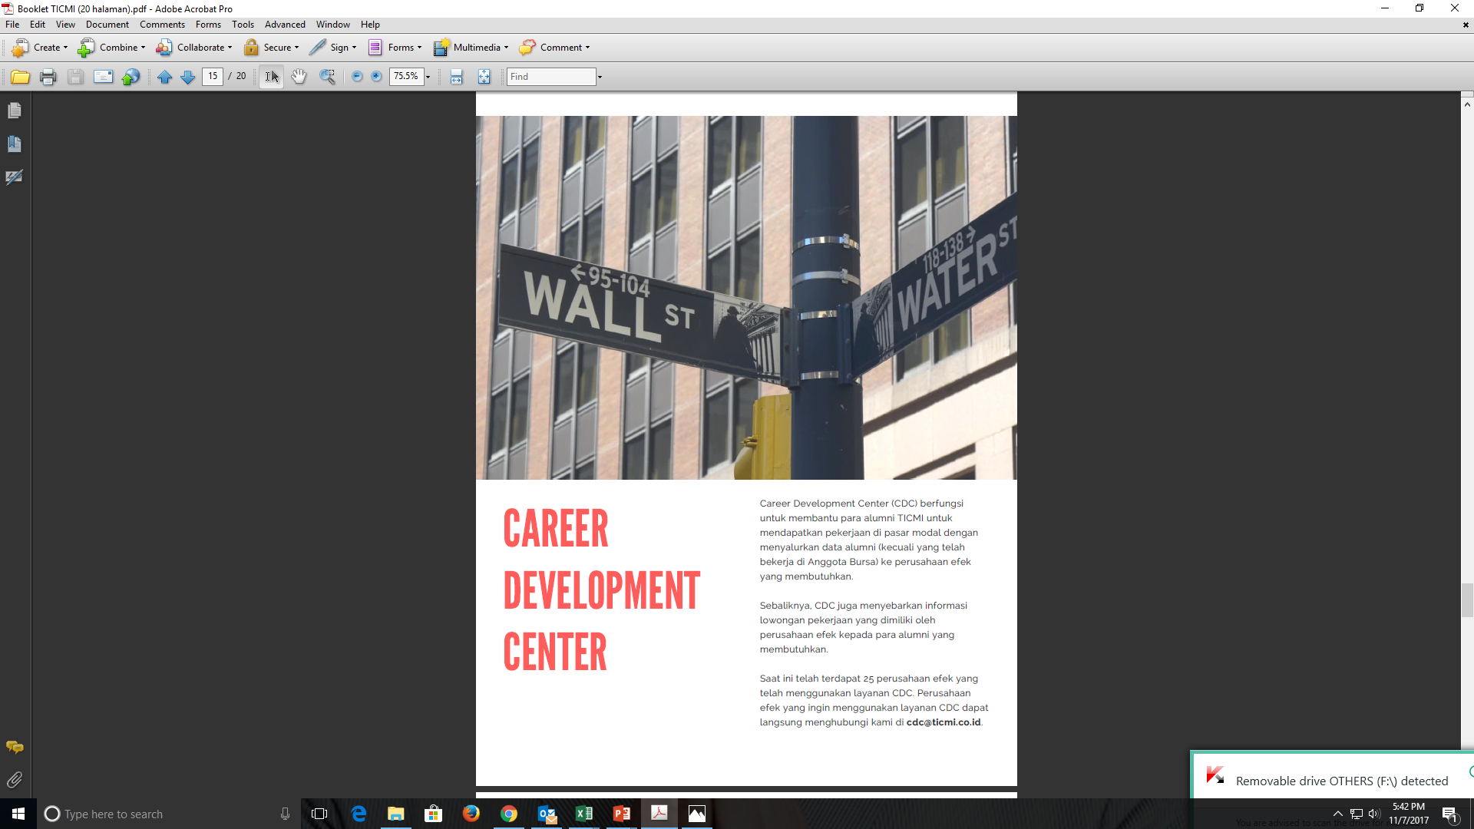

Slide 33
Our Partners
No | University | City
1 | Universitas Syiah Kuala | Banda Aceh
2 | IAIN Langsa | Banda Aceh
3 | UIN Sumatera Utara | Medan
4 | Universitas Andalas | Padang
5 | Universitas Batu Sangkar | Padang
6 | Politeknik Negeri Padang | Padang
7 | Universitas Putra Indonesia YPTK | Padang
8 | Universitas Riau | Riau
9 | Universitas Muhammadiyah Riau | Riau
10 | Universitas Riau Kepulauan | Batam
11 | Politeknik Negeri Batam | Batam
12 | UIN Sultan Thaha Saifuddin | Jambi
13 | Universitas Bangka Belitung | Pangkal Pinang
14 | STIE IBEK Bangka Belitung | Pangkal Pinang
15 | Universitas Muhammadiyah Palembang | Palembang
16 | Universitas Musi Charitas | Palembang
17 | Universitas Bengkulu | Bengkulu
18 | IAIN Bengkulu | Bengkulu
No | University | City
19 | UIN Sultan Maulana Hasanuddin | Tangerang
20 | Matana University | Tangerang
21 | STIE Trisakti | Jakarta
22 | Universitas Mercubuana | Jakarta
23 | Universitas MH Thamrin | Jakarta
24 | Universitas Esa Unggul | Jakarta
25 | Indonesia Banking School | Jakarta
26 | ESQ Business School | Jakarta
27 | STIE Pelita Bangsa | Bekasi
28 | STIE Kesatuan | Bogor
29 | Universitas Langlangbuana | Bandung
30 | Universitas Widyatama | Bandung
31 | Universitas Diponegoro | Semarang
32 | Universitas Negeri Semarang | Semarang
33 | Unika Soegijapranata | Semarang
34 | Universitas Negeri Semarang | Semarang
35 | Universitas Kristen Satya Wacana | Salatiga
36 | Universitas Batik Surakarta | Solo

Slide 34
Our Partners
No | University | City
37 | Universitas Gadjah Mada | Yogyakarta
38 | Universitas Islam Indonesia | Yogyakarta
39 | Universitas Negeri Yogyakarta | Yogyakarta
40 | AA YKPN | Yogyakarta
41 | Universitas Airlangga | Surabaya
42 | Universitas Brawijaya | Malang
43 | Universitas Kanjuruhan | Malang
44 | STIE Urip Sumoharjo | Malang
45 | Universitas Udayana | Denpasar
No | University | City
46 | STIE Widya Dharma | Pontianak
47 | Universitas Palangakaraya | Palangkaraya
48 | Universitas Darwan Ali | Palangkaraya
49 | Universitas Islam Kalimantan | Banjarmasin
50 | IAIN Antasari | Banjarmasin
51 | Universitas Lambung Mangkurat | Banjarmasin
52 | Universitas Balikpapan | Balikpapan
53 | Universitas Muhammadiyah Gorontalo | Gorontalo
54 | Universitas Sam Ratulangi | Manado
55 | Universitas Klabat | Manado
56 | Universitas Hasanuddin | Makassar
57 | Universitas Negeri Makassar | Makassar
58 | STIE Nobel | Makassar
59 | STIEM Bongaya | Makassar
60 | STIM Nitro | Makassar
61 | Universitas Halu Oleo | Kendari
62 | Universitas Pattimura | Ambon
63 | Universitas Papua | Manokwari
64 | Universitas Yapis Papua | Jayapura

Slide 35
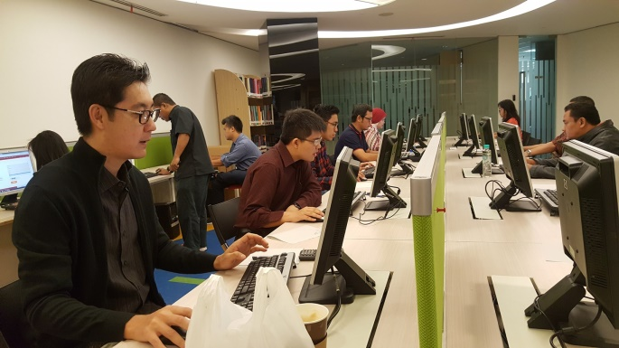
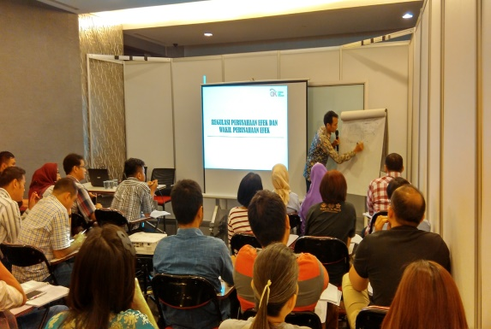
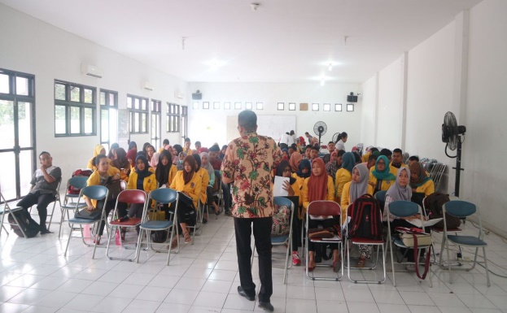
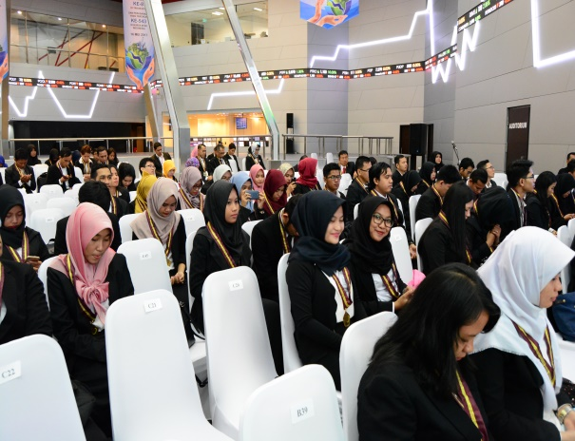
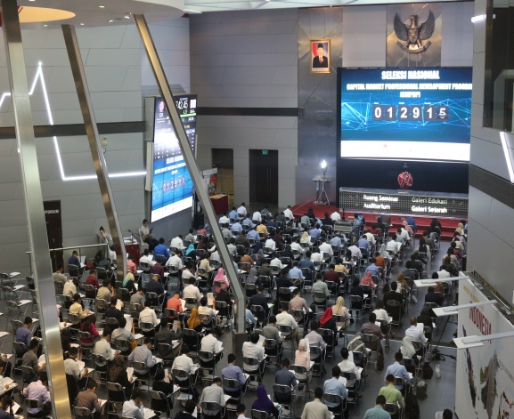
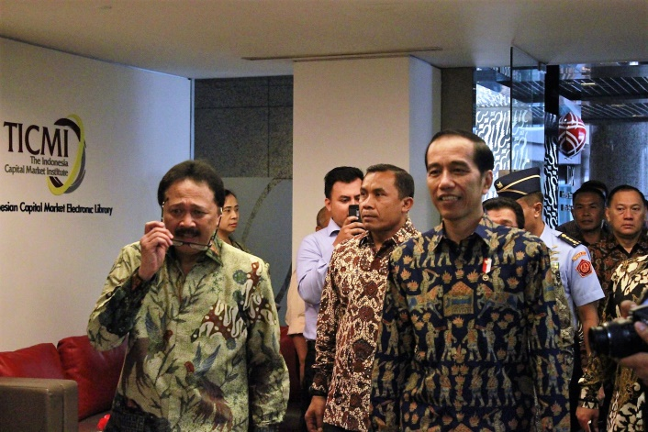
Gallery
Data & information access at TICMI office
Capital Market School at
Indonesia Stock Exchange
WPPE Certification Class at
Local University
2017 Certification Holders
Graduation at Indonesia Stock Exchange
2017 Capital Market Professional
Development Program
National Selection Chapter Jakarta
The President, Minister of Finance, Central Bank Governor, Head of Indonesia FSA, and CEO of Indonesia Stock Exchange visit to TICMI office

Slide 36

ARE YOU IN ?

Slide 37



Informasi Detail
0800 100 9000 (toll Free)
info@ticmi.co.id
ticmi.co.id

Slide 38




Informasi Detail
TICMI.ID
@TICMI_ID
@ticmi_id
The Indonesia Capital Market Institute

Slide 39


